Slide 1
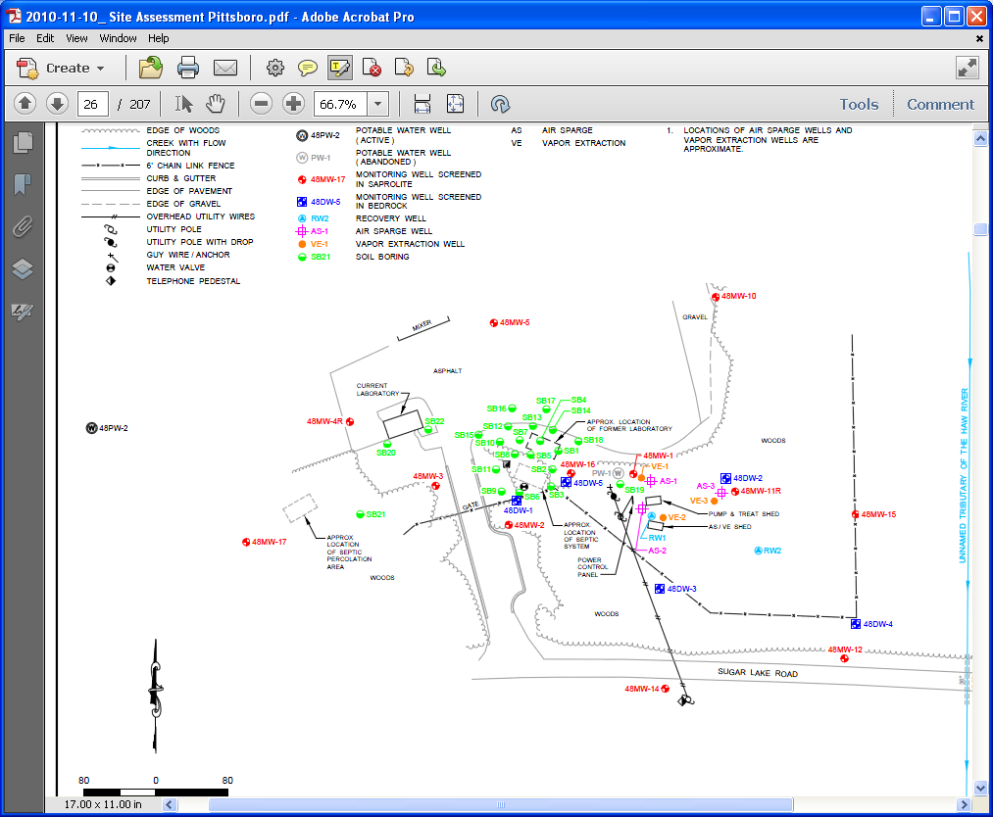
Soil boring locations in green 2010

Slide 2
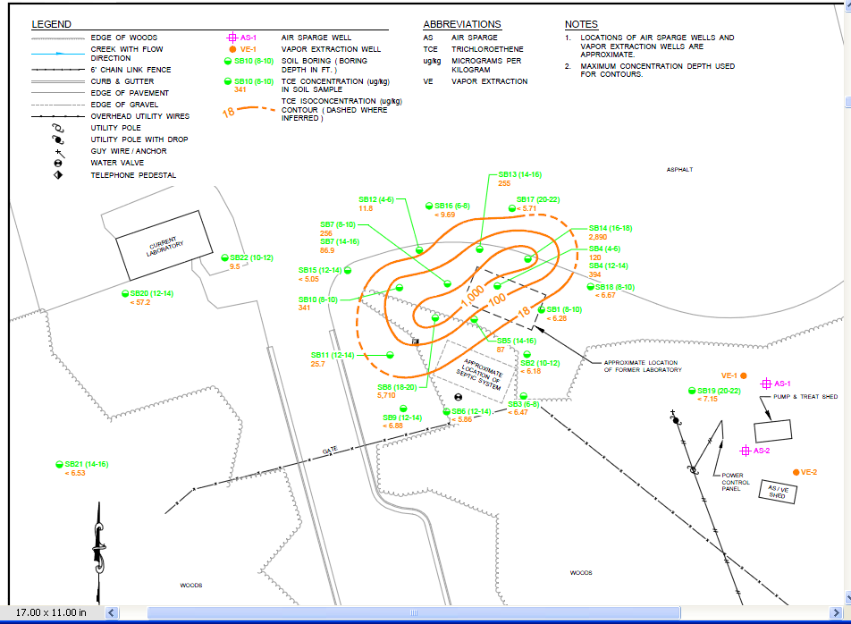

Slide 3
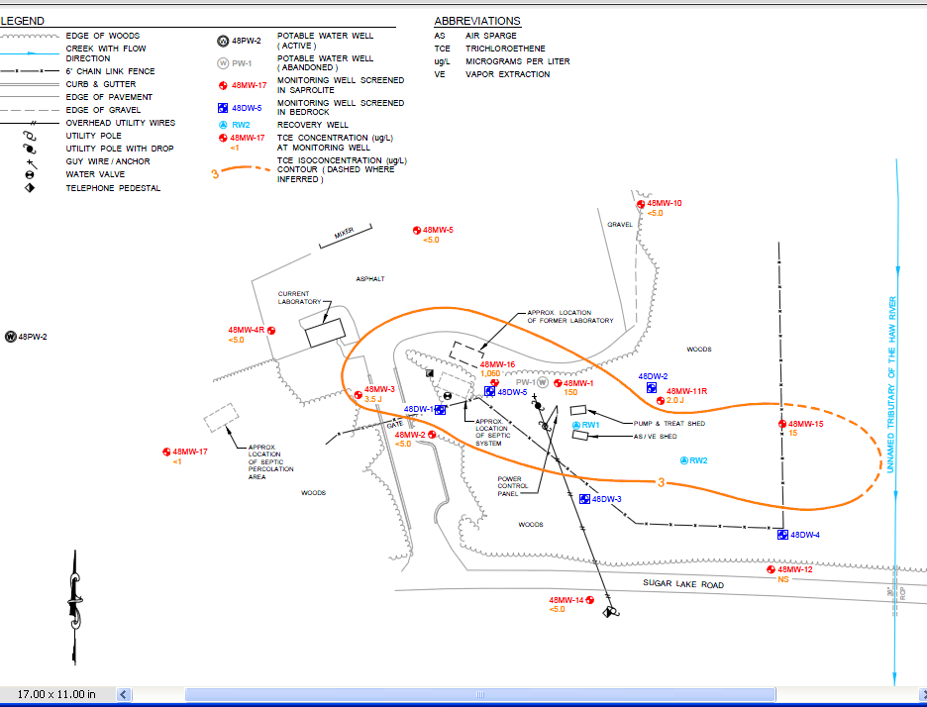

Slide 4
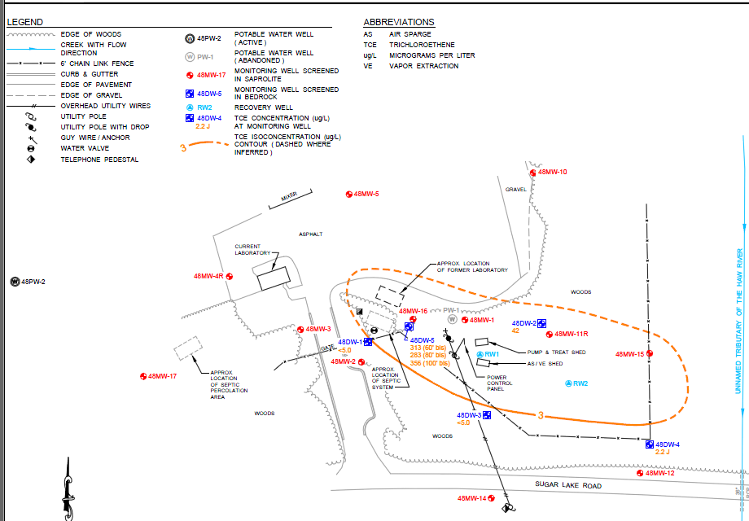

Slide 5
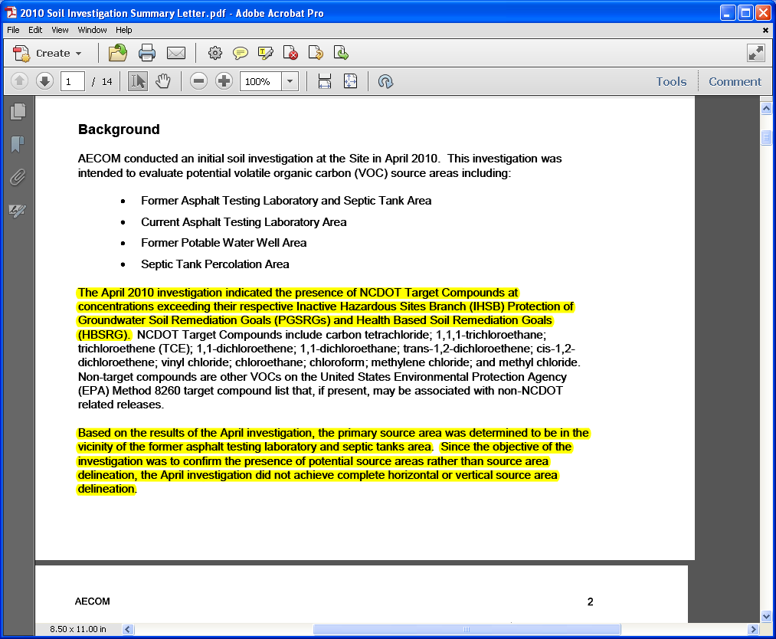

Slide 7
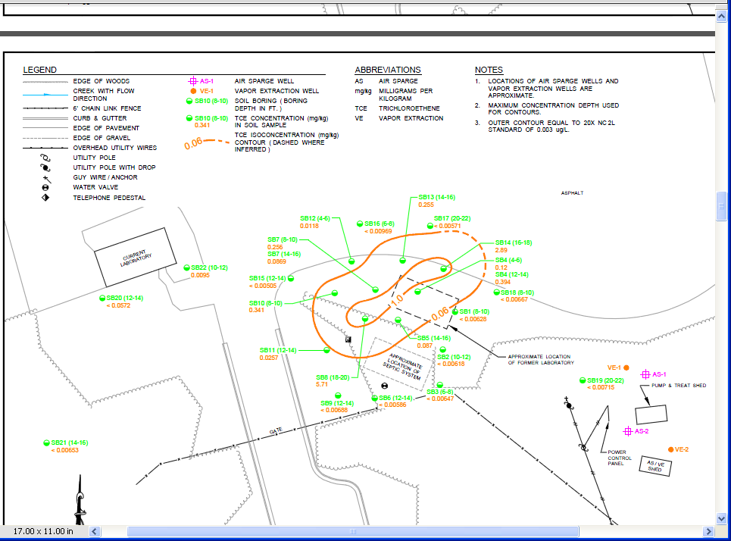

Slide 8
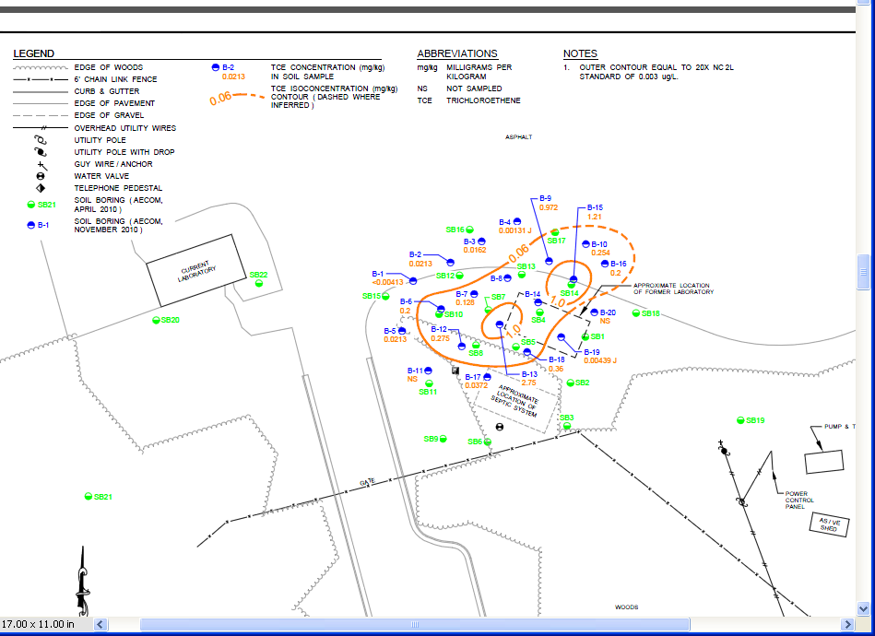

Slide 9
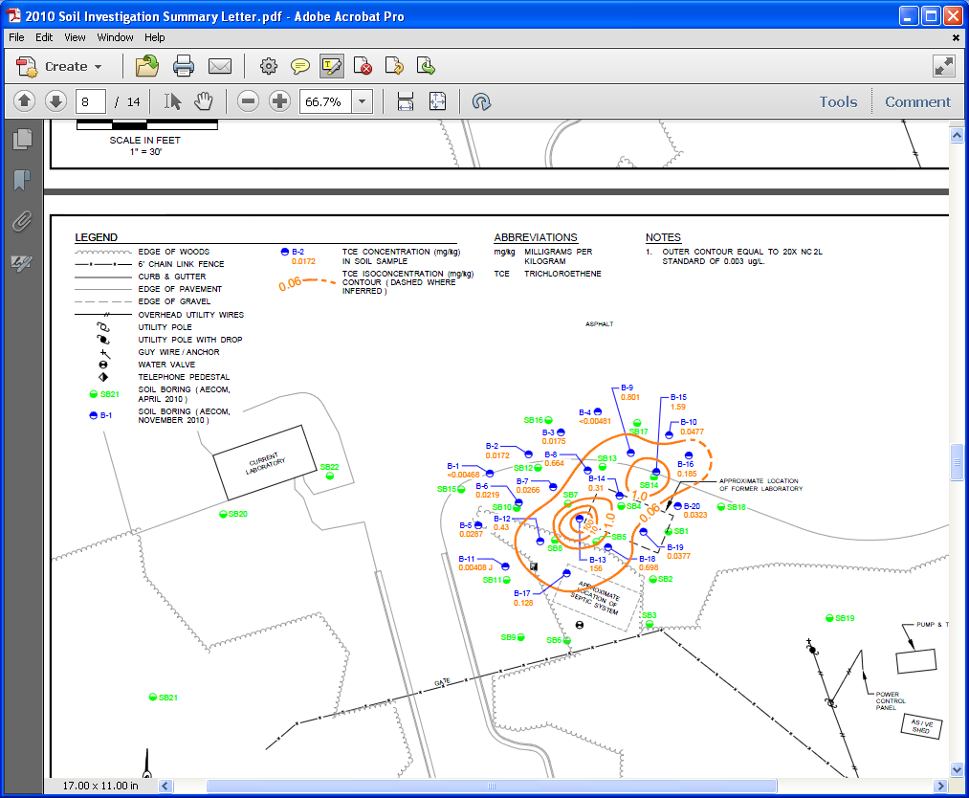

Slide 10
This starts the latest report 2012

Slide 11
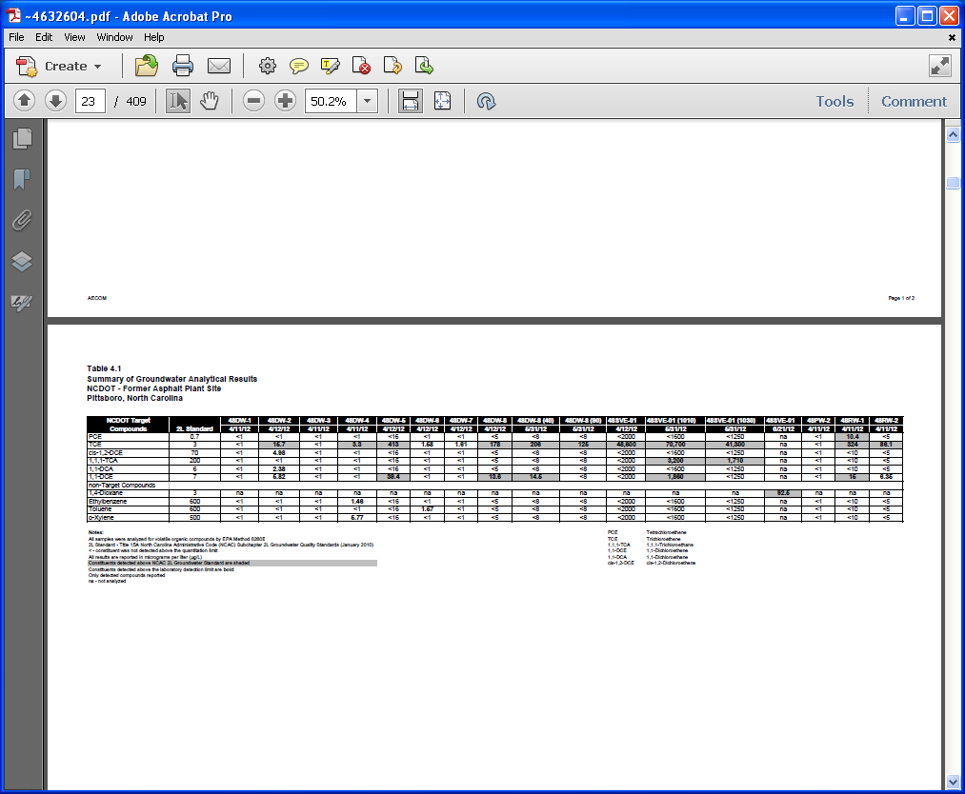

Slide 13
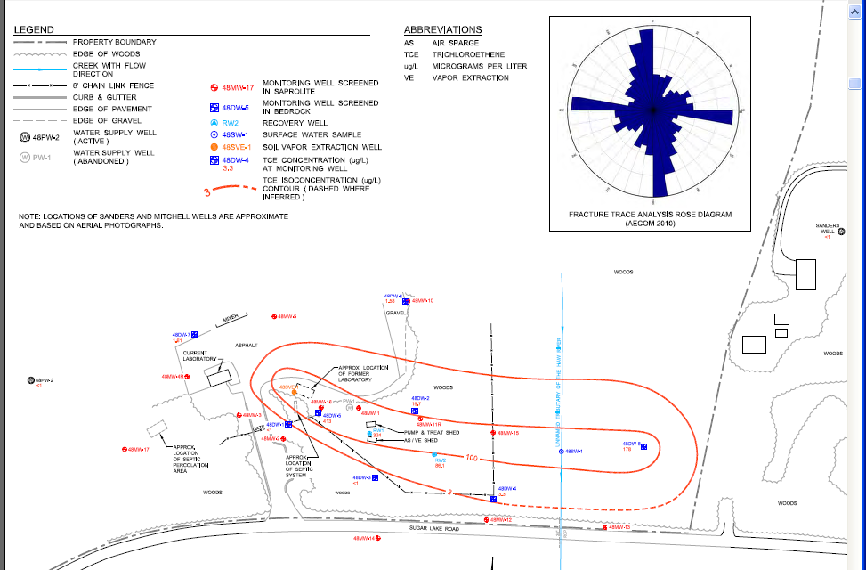

Slide 14
ST WOOTEN purchased #22 and wants to request
Industrial use on zoned residential/agr property

Slide 15
New ST Wooten 50 gallon/min
water supply well !
Stream TCE exceeded 2B std 5/22 X sampled

Slide 16
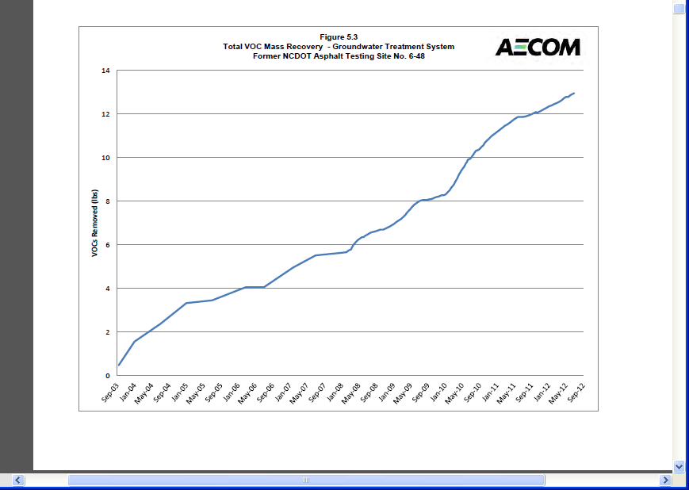
13 lbs removed from 2003 2012

Slide 17
